Slide 1
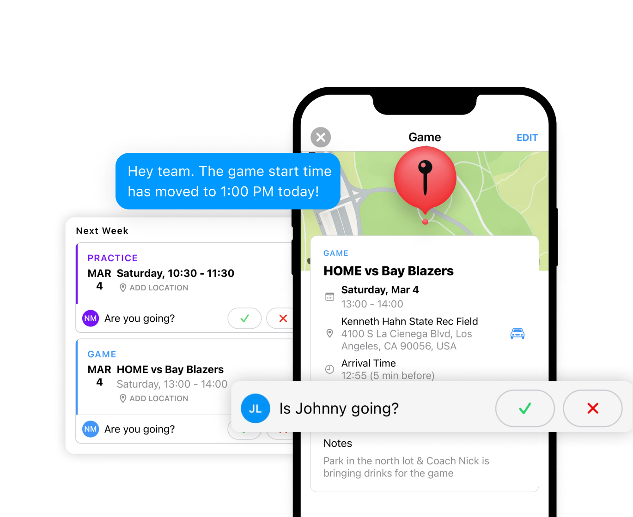

WELCOME TO MOJO!
MOJO is an all-in-one youth sports app that makes it easy to coach, manage and never miss a moment.
With MOJO, you can schedule practices and games, keep track of attendance, and message your team.
In addition to simplified team management tools, MOJO has hundreds of team drills and activities to make coaching easy.

Slide 2
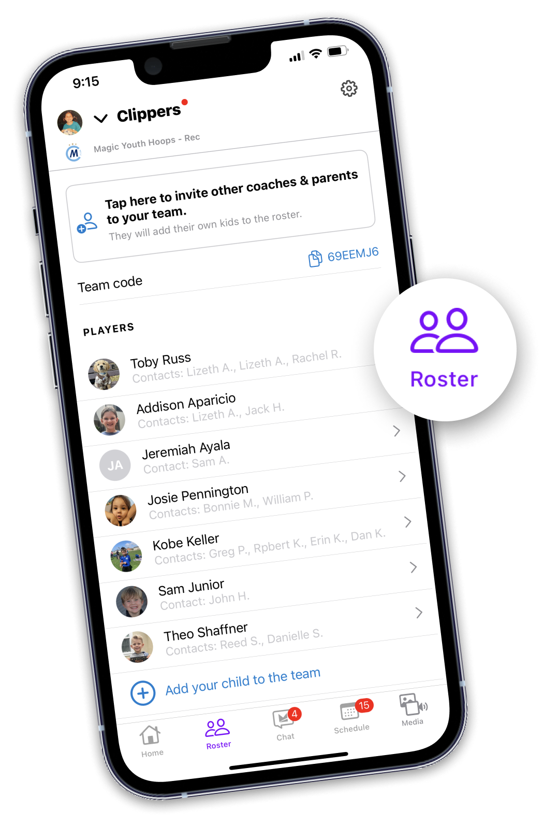
ROSTER
View contact information, promote a parent to coach, or invite additional parents or guardians to the team from the Roster tab.

Slide 3
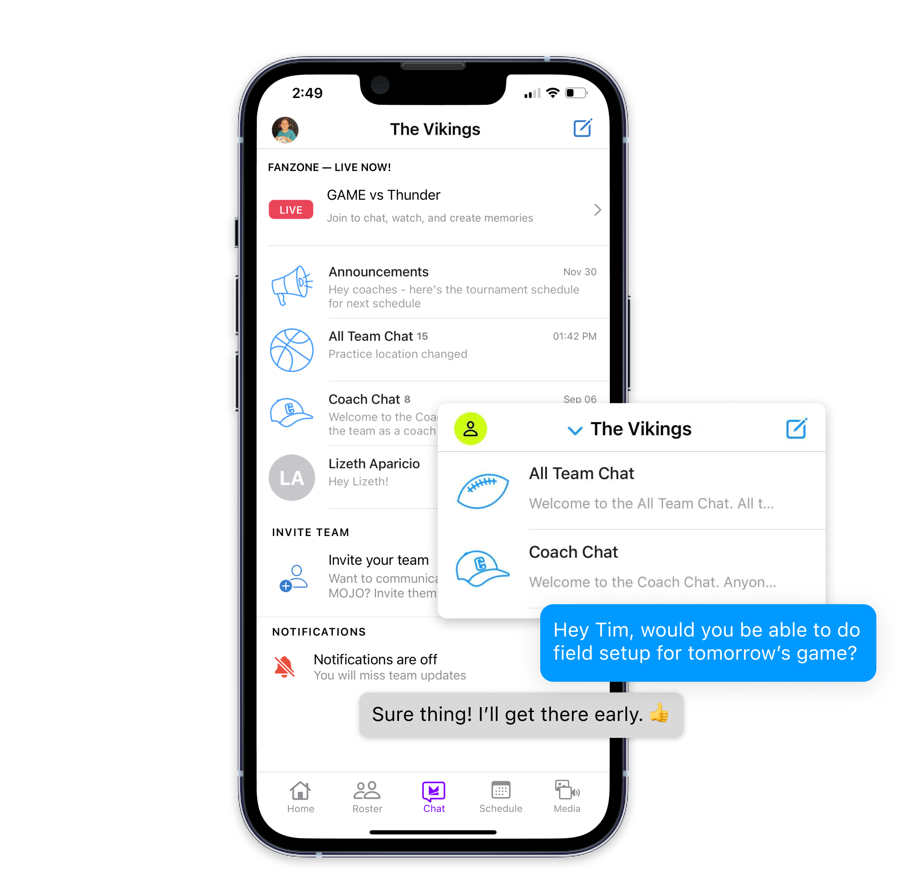
CHAT
Message the entire team, just other coaches, or a select group of parents.
Send a direct message to your league administrators.
Easily share events, practice activities, photos, videos, and more in Chat.

Slide 4
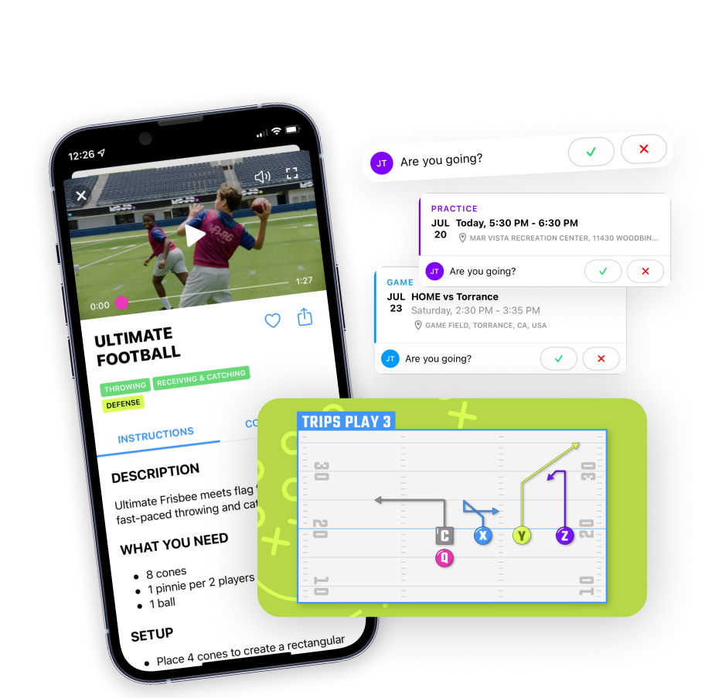
SCHEDULE (AND PRACTICE PLANS)
Your practices and games will either be preloaded into the app, or you can add them on your own.
For each practice, you will find a curated practice plan with videos to make coaching easier.
You can also browse the MOJO library, edit the practice plan, and upload your own drills.

Slide 5
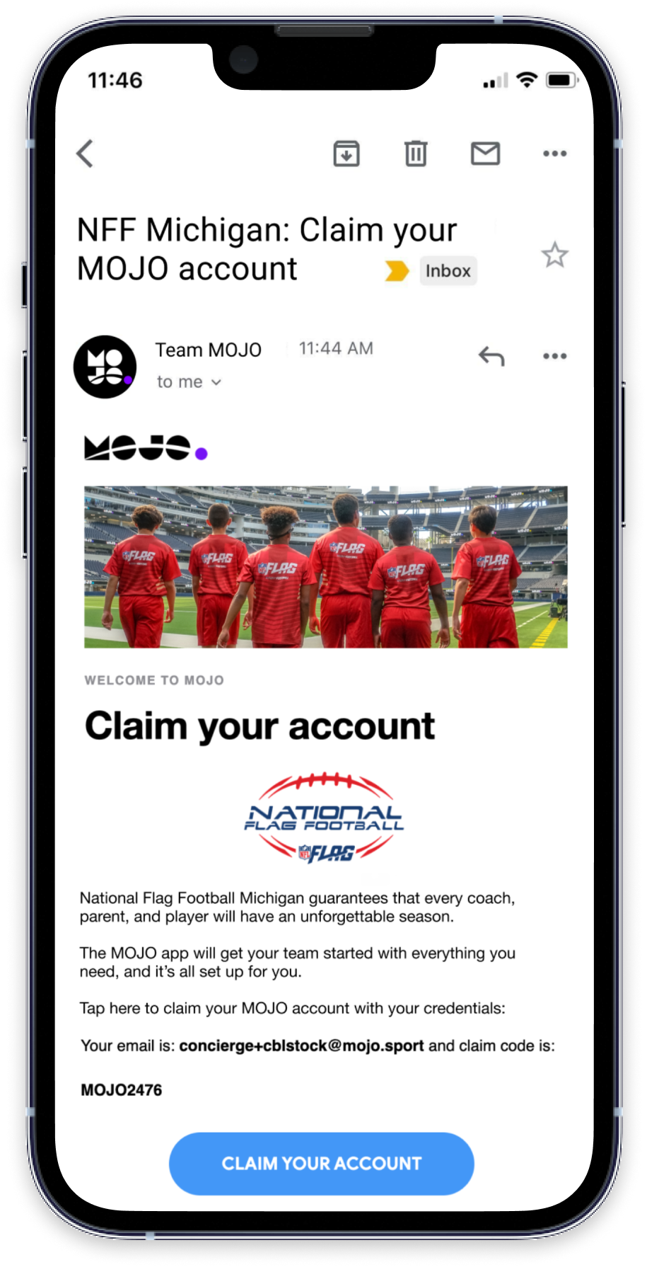
LET’S GET STARTED!
What happens next?
You’ll receive an email and/or text message when your account is ready.
Use your claim code to sign in and go!
Your team will be set up for you: rosters, schedules, and more…
Questions or issues? Contact support@mojo.sport

