Slide 1

Southeast Region
Pop Warner
Scholastics 2023

Slide 2
National Changes to Scholastics
Effective 2023 a new process for enforcing the minimum academic standard was enforced. In similar fashion to our background checks, we’re leaving this with our leagues at the point of certification. Each league will file an affidavit attesting to the scholastic fitness of participating student-athletes. As a result, report cards are no longer required in “the book” or any audit before competition.
All-American Scholars
  This year’s All-American Scholars are expected to be announced in early May via PopWarner.com and on Pop Warner’s social media channels.
  All scholar award recipients will once again be notified and sent a digital certificate via email.

Slide 3
Southeast Region
Pop Warner Regulations for Scholastics
Report cards or relevant scholastic forms will be collected by Associations at sign-ups and loaded in the Stack-Sports Software in the athlete’s record prior to certification.
Athletes above the 5th grade will need a grade conversion sheet completed to see if they qualify for All American status. These grade conversion sheets will be maintained by the association scholastics coordinators. If an athlete qualifies for All American, then the association scholastics coordinator will file appropriate All American paperwork with the League Scholastics Coordinator prior to the deadline.
Athletes that require progress reports, need to complete them between September 1 – October 15. They will submit them to the League Scholastics Coordinators before the October 15 deadline.

Slide 4
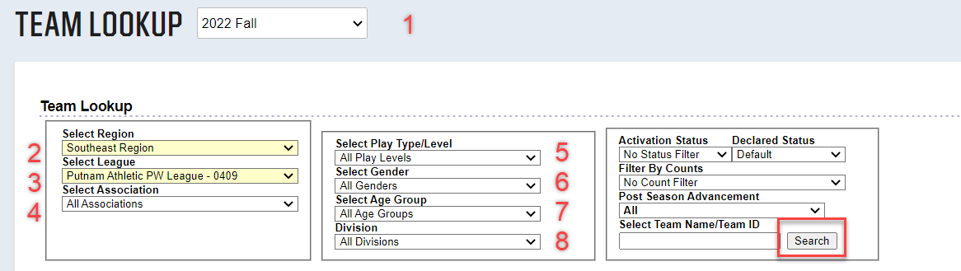
Scholastics certification by Leagues
Log into Stack Sports: https://popwarner.sportsaffinity.com/
Select the “Teams” from the Menu bar
Select “Team Look Up”
All Genders (always)
All Age Groups (Always)
All Divisions (Always)
Select Search
Select the current Season.
Select the Region (you may not see this option)
Select the League (you may not see this option)
Select the Association
Choose your Play Level (I usually leave this at All Play Levels)

Slide 5
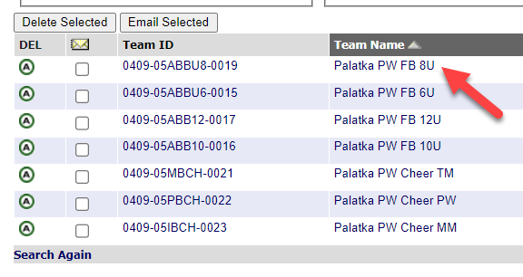
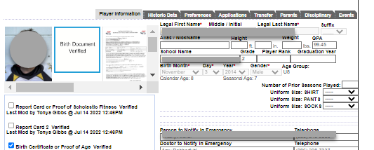
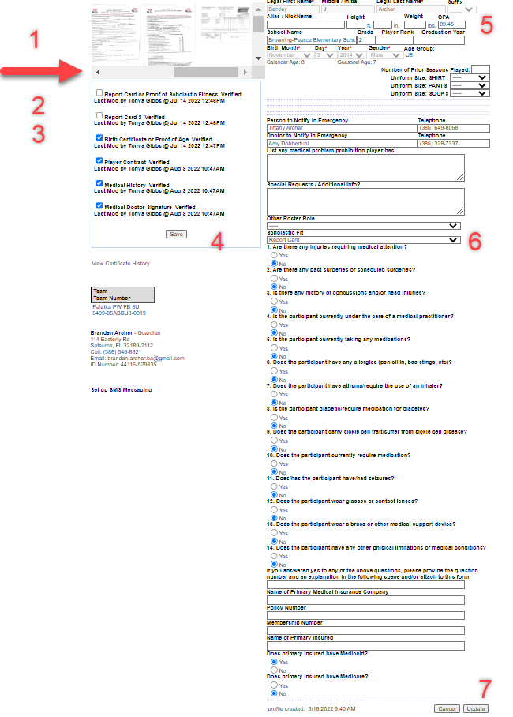
10. List of rosters will appear.
11. Click the “Team Name” to open a roster.
Click the Athlete’s name to open a record.
Scroll to the right to find the scholastics box. If it is empty notify the association. Double click the report card / SEF form to open the box. Examine the form for accuracy.
  Name, school year, quarters attended, GPA.
If accurate, validate the report card with a check. If not accurate, delete the document from the box, and notify the association that a new copy is needed.
Report Card 2 box is to validate the acceptance of a progress report received by the Oct 15 deadline.
Press save to accept any check mark certifications.
Place appropriate GPA in the box. (See GPA key)
Select appropriate Scholastics provided from the list.
Press Update to Save Changes to Athlete’s record.
Click “next” in the upper right hand corner to go to the next athlete on the roster.
GPA KEY:
Pre-K & Kindergarten Form 70%
4th Grade and below - 70%
5th Grade and above – Calculated GPA
Homeschool - 70%
Scholastic Eligibility Form (SEF) – 59%
*Use GPA calculation sheet. Keep the sheet for your records, DO NOT UPLOAD TO ROSTER SOFTWARE. If the athlete qualifies for All-American, turn the calculation sheets in with the applications.

Slide 6
Links to Helpful Reports
Scholastics & Compliance
Scholastics Report
Compliance Reports are called Dynamic Certificate Data: There are two reports that can be ran to tell if all the paperwork has been uploaded for a season. Admin Dynamic Certificate Data and the Player Dynamic Certificate Data.
There are Pros & Cons.
  Athletes Pro – it lists all Athletes in the current season
  Athletes Con – it does show roster placement. However, you may be able to do some fancy age sorting to figure out their teams.
  Admin Pro – It lists every admin. Past and present
  Admin Con – No one is assigned to a team.
  Athlete Report is called the:
Batch Printing Rosters
RCDC Report

