Slide 1
Updates to Laws of the Game
(25/26 Law Changes)
Notes:
Clicking to the Next slide will start the US Soccer Referee Abuse Prevention video.

Slide 2
Law 3: The Players
Law 3.10 (Team captain), guidelines have been introduced into the Laws for any competitions wishing to apply the principle of only the captain approaching the referee in specific situations.
AYSO will not require communication with the referee to only be made by the Captain(s)
2

Slide 3
Law 8: The Start and Restart of Play
Law 8.2 (Dropped ball): If the ball is outside the penalty area when play is stopped, it is dropped for the team that had or would have gained possession if this is clear to the referee; otherwise, it is dropped for the team that last touched it. The ball is dropped at its position when play was stopped

Slide 4
Law 9: The Ball in and out of Play
Law 9.2 (Ball in play): An indirect free kick with no disciplinary sanction will be awarded if a team official, substitute, substituted or sent-off player or player who is temporarily off the field of play touches the ball as it is leaving the field of play and there was no intention to interfere unfairly

Slide 5
Law 12: Fouls and Misconduct (Cont’d)
Law 12.2 (Indirect free kick). If a goalkeeper holds the ball for longer than eight seconds (with the referee using a visual five-second countdown), the referee will award a corner kick to the opposing team (rather than the current indirect free kick for more than six seconds).
Please use your voice to encourage the keeper to put the ball back into play
Notes:
Remember this law is in place to avoid time wasting. In most of our matches, the player is confused as to what to do and is not attempting to waste time. Help the player by simply encouraging them to put the ball back into play.

Slide 6
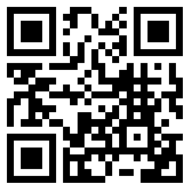
Get Familiar with Updated Laws
Download documents from the IFAB
https://www.theifab.com/documents
Recommend using the official app of the IFAB
https://www.theifab.com/logapp/

